Slide 1

Software Engineering
Introduction to Software Engineering
Requirement Elicitation & Requirement Analysis
Acknowledgement: Authors of the prescribed textbooks and materials sourced online.

Slide 2

List of Contents
Process of Requirement Elicitation
Elicitation Techniques
Process of Requirement Analysis
UML
Conceptual UML Model
Using a Use Case diagram

Slide 3

Process of Requirement Elicitation
It is the process of working proactively with all stakeholders gathering their needs, articulating their problem, identify and negotiate potential conflicts thereby establishing a clear scope and boundary for a project.
It involves:
▪ Understanding the problem
▪ Understanding the domain
▪ Identifying clear objectives
▪ Understanding the needs
▪ Understanding constraints of the system stake holders
▪ Writing business objectives for the project

Slide 4
Elicitation Techniques
Approach is based on
Nature of the system being developed
Background and experience of stakeholders
Elicitation techniques
Active
Passive
Ongoing interaction between the stake holders and users.
Infrequent interaction between the stake holders and users.
• Interviews
• Facilitated meetings
• Role-playing
• Prototypes
• Ethnography
• Scenarios
• Use cases
• Business process analysis & modelling
• Workflows
• Questionnaires
• Checklists
• Documentation

Slide 5
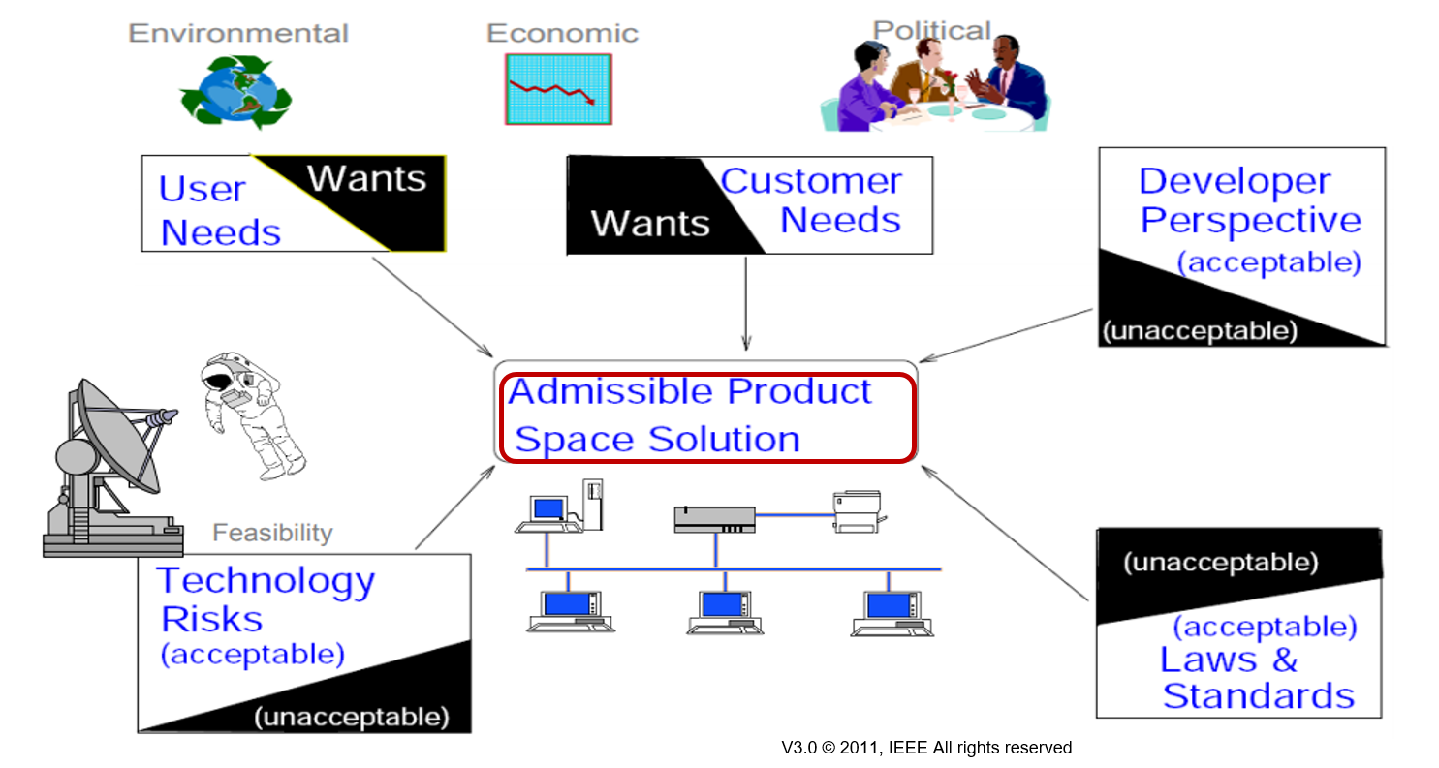
Process of Requirement Analysis
Requirements represent compromise

Slide 6
Process of Requirement Analysis
1. Understand requirements in depth
2. Classify requirements into coherent clusters
3. Model the requirements
4. Analyze requirements using fish bone diagram
5. Recognize and resolve conflicts
6. Negotiate requirements
7. Prioritize requirements - MoSCoW
8. Identify risks
9. Decide on build or buy – COTS solution

Slide 7
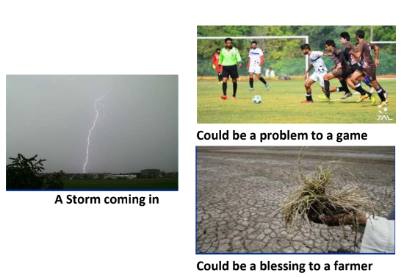
Process of Requirement Analysis
Understand requirements in depth
This has to be done from a product and a process perspective
Requirement or Problem needs to be correctly internalized

Slide 8
Process of Requirement Analysis
Functional Requirements
Functionality or services, the system should provide with different inputs, and expression on how the
system should behave in particular situations
Classify requirements into coherent clusters
Domain Requirements Constraints on the system from the domain of operation
User Requirements
Statements in natural language plus informal context diagrams
system/sub-system and their interconnections and operational constraints. Written for/by customers.
System Requirements
A structured document setting out detailed descriptions of the
system’s functions, services and operational constraints. Defines what should be implemented so may be part of a
contract between client and contractor.
Also called Software requirements or Functional specifications
Non-Functional Requirements
Constraints on the services or functions offered by the system such as timing constraints, constraints on
the development process, standards

Slide 9
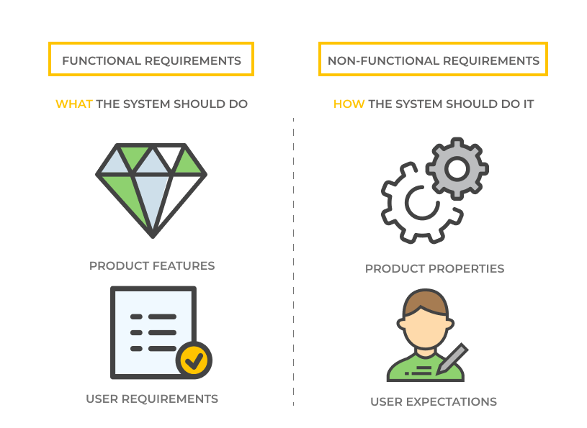
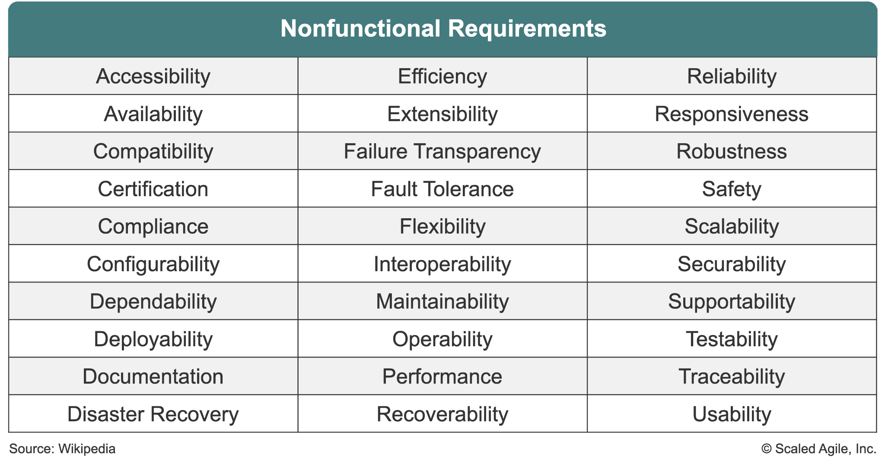
Functional & Non-Functional Requirements
‹#›

Slide 10
Identify the Class of Requirement
System shall assign a unique tracking number to each shipment
Functional Requirement
With 100 concurrent users a database record shall be fetched over the network in less than 3ms
Non-Functional Requirement

Slide 11
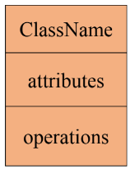

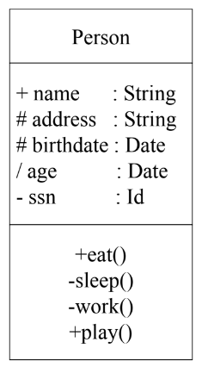
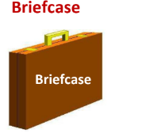
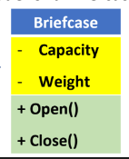
Process of Requirement Analysis
Model the requirements
A model is a representation of a system in some form.
A is a model of B if A can be used to answer questions about B.
We can use the following Class notation as a model.
For example, to represent a person –
Think about it
Try to model a briefcase similarly
+, #, - and ~ are types of visibility
+: public
- : private
#: protected
~: package

Slide 12
Process of Requirement Analysis
Primary goals of Modelling
• Providing an Understanding (existing) System
• Communicating the requirements in terms of who, what and interpreting it in the same way
Models could be Structural Models and Behavioral models
Structural Models
• Captures static aspects of system
• What entities exist in the system?
• How are they related?
Example: Class diagram
Behavioral Models
• Captures dynamic aspects of the system
• How do the entities interact in response to a stimulus?
Example: Use Case diagram
Use-case models discussed earlier are the popular models used during analysis

Slide 13
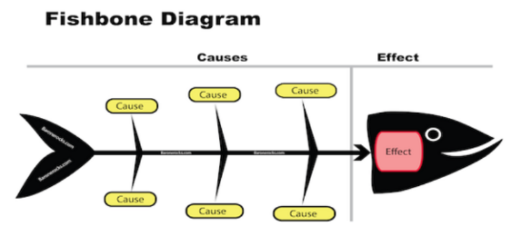
Process of Requirement Analysis
Analyze requirements using fish bone diagram
List out all the reasons/causes on why the requirement (effect) has come in
and become relevant
A fishbone diagram, also known as an Ishikawa or cause-and-effect diagram, is a visual tool used to identify and organize potential causes of a specific problem. Developed by Kaoru Ishikawa, it resembles a fish skeleton with the problem (effect) at the "head" and the main categories of causes (such as methods, materials, machinery, people, environment, and measurement) branching off the "spine." This structured approach helps teams systematically explore and identify root causes, facilitating effective problem-solving and quality management.

Slide 14
Process of Requirement Analysis
Recognize and resolve conflicts
Functionality vs Cost vs Timelines
Negotiate requirements
Prioritize the requirements (MoSCoW -Must have, Should have, Could have, Won’t have)
Pareto Analysis in software requirement analysis involves using the 80-20 rule to prioritize key software features (vital few) that hold the most value or impact, while relegating less critical features (trivial many) to lower priority. This approach ensures that essential requirements are addressed first, optimizing resource allocation and development efforts. Ultimately, it streamlines software development by focusing on high-impact aspects before tackling less significant ones.

Slide 15
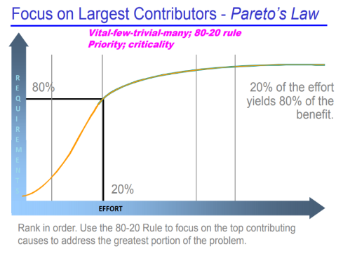
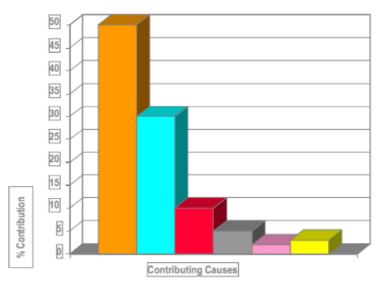
Process of Requirement Analysis

Slide 16

Process of Requirement Analysis
Identify risks
Decide on build or buy – COTS solution
Commercial Off The Shelf solution – COTS
COTS, or Commercial Off-The-Shelf, refers to ready-made software or hardware products that are readily available for purchase and use. These products are designed to be easily integrated into existing systems without the need for extensive customization.

Slide 17
Unified Modelling Language – UML
What is UML?
UML (Unified Modeling Language) is a standard language for specifying, visualizing, constructing, and documenting the artifacts of complex software systems. Controlled by OMG consortium – Object Management Group.
UML plays an important role in defining different perspectives of a system
Design
Implementation
Process
Deployment
Use Case view representing the functionality of the system connecting all of them
Why is UML used?
UML Use-case models are predominantly used with Modeling Systems, to discuss the dynamic behavior of the system when it is running/operating. Its often used to used to gather the requirements of a system including internal and external influences.
Link : https://www.geeksforgeeks.org/unified-modeling-language-uml-class-diagrams/

Slide 18
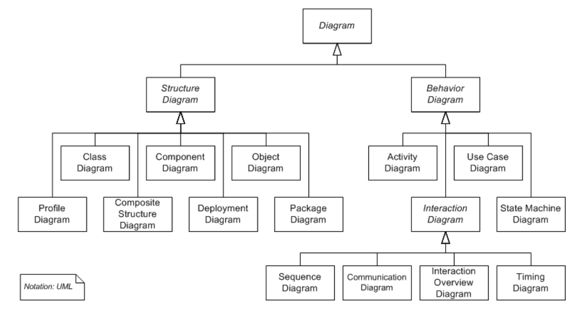
Unified Modelling Language – UML

Slide 19
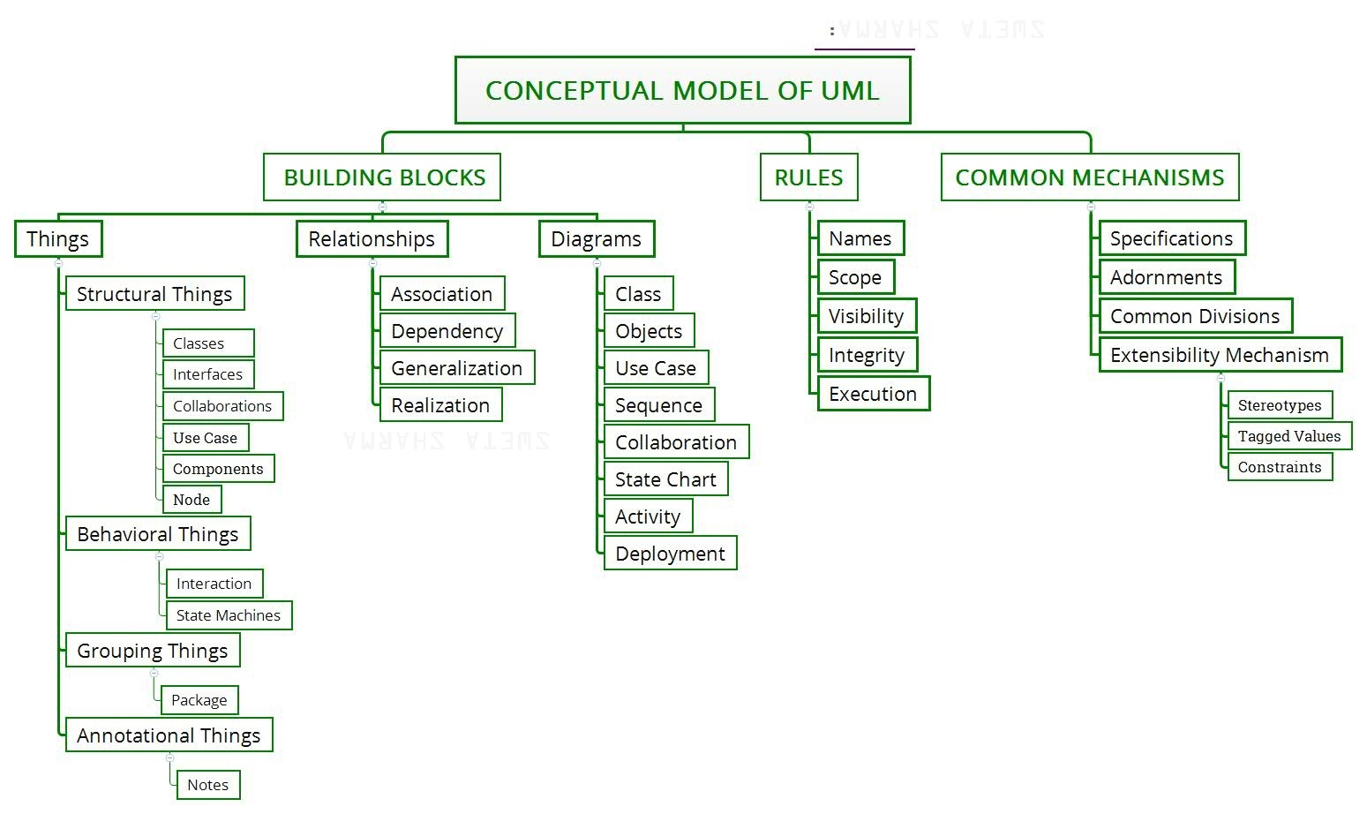
Conceptual UML model
UML is made up of three conceptual elements. They are
• Building blocks which make up the UML
• Rules that dictate how these building blocks can be put together
• Common mechanisms that apply through out UML
Use case is a description of set of sequences of actions
that a system performs that yields an observable result
of value to a particular actor
https://www.geeksforgeeks.org/conceptual-model-of-the-unified-modeling-language-uml/

Slide 20
Conceptual UML model contd.
Use Case Diagram
shows actors, use cases,
and relationships
Diagrams – Graphical
representation of set of elements,
often rendered as a set of
connected graph of vertices
(things) and arcs (relationships).
It’s a projection into the system
Relationship ties together
the things or abstractions.
There are four different
kinds of relationships
Things are abstractions in the model.
There are four kinds of things or
abstraction

Slide 21
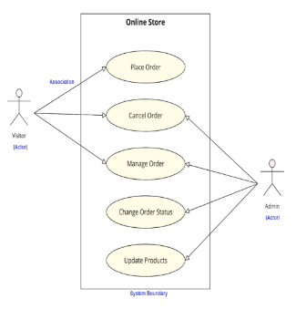
Using Use Case diagram
Use case from a user’s point of view outlines how the proposed system will perform a task expected to be performed, while responding to a request or task of a role/actor/user.
Use case diagrams are used to visualize, specify, construct, and
document the (intended) behavior of the system, during
requirements capture and analysis. Used by developers, domain experts and end-users.
Actor is someone (can be a human or other external system)
interacting with the use case (system function), named by noun but is not part of the system.
Link : https://www.geeksforgeeks.org/use-case-diagram/?ref=lbp

Slide 22
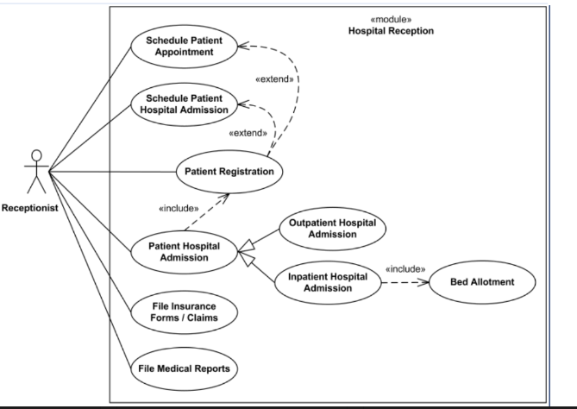
Use Case Diagram – In-Class Exercise
Using Use Case diagram, to depict the job of a hospital receptionist. Include scheduling appointments, admissions, bed allotment, filing insurance and filing medical reports as some of the use cases.

Slide 23
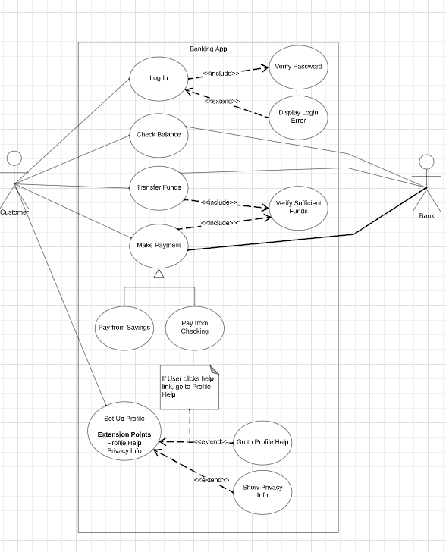
Use Case Diagram- Banking System

Slide 24
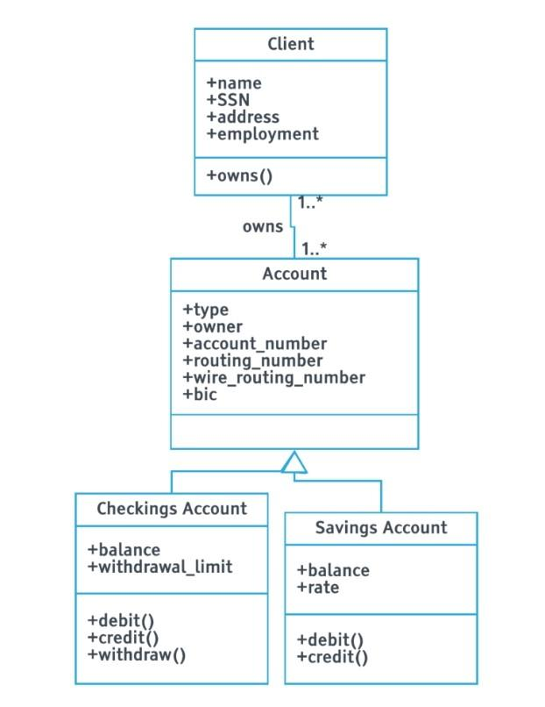
Class Diagram- Banking System(part of the system)

Slide 25
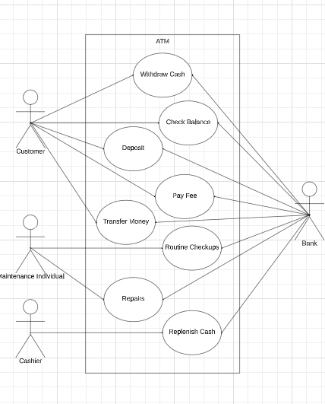
Use Case Diagram- ATM

Slide 26
THANK YOU

